Slide 1
Vlambeer Webshop
Sprint 1

Slide 2
Inhoudsopgave
Wireframes
Header
Image slider
Home
Game designs

Slide 3
Wireframes
Home page
Store

Slide 4

Header
Geanimeerde logo
Slogan

Slide 5
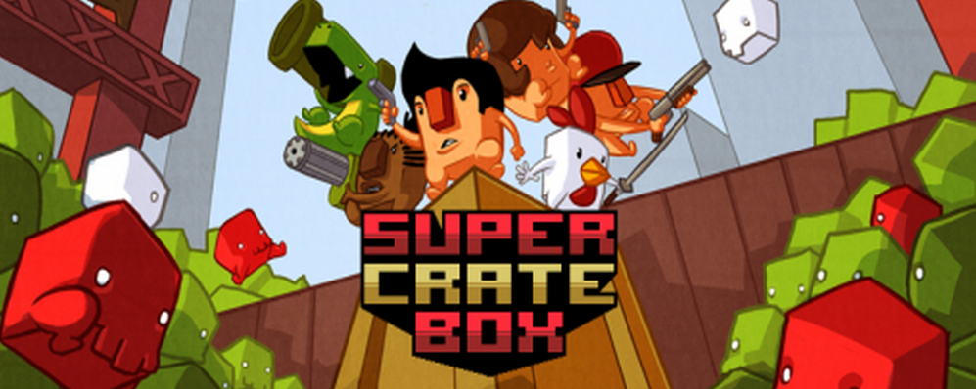
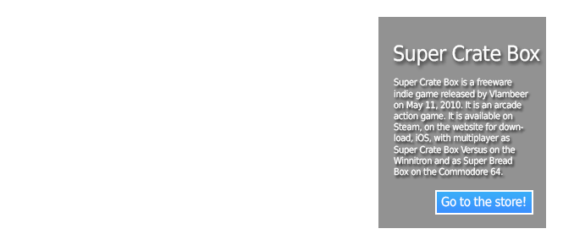

Image slider
jQuery
Images

Slide 6
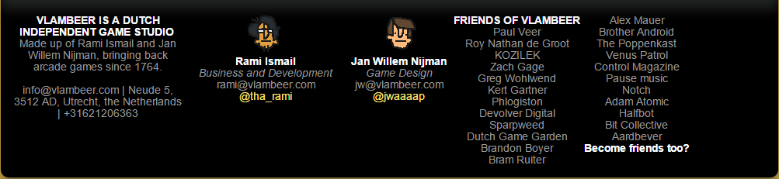
Home
Header
Buttons
News
Footer

Slide 7
Game designs
Super Crate Box
Gun Godz
Serious Sam

